Slide 1
Verified Blockchain Protocol
Design specifications

Slide 2
What is the Verified blockchain used for ?
Verified blockchain is not an application like Bitcoin
Verified does not provide a smart contract engine like Ethereum
Verified does not store a global application state like Ethereum
Multiple applications can run on the Verified blockchain which provides a thin consensus layer.
3rd party apps
Implemented in any language
Identified by public/private key
Verified client
Authenticates 3rd party apps
Authorizes 3rd party apps
Verified transaction layer
Certifies transactions
Verifies transactions

Slide 3
Authenticating and Authorizing clients
AUTHENTICATION
Self generated public/private key pair by Verified peer
Key generated using Verified peer’s Infohash (peer key)
Public key and Private key encrypted with hash function using seed (which is combination of Infohash+password)
Encrypted Public Key and Private Key (as values) stored on opendht using put operation for key (=seed)
Public and Private Key are retrieved using seed when app/user re-logs in. If seed is correct, then encrypted private/public key can be correctly retrieved and decrypted.
AUTHORIZATION
For each transaction, a small amount denominated in Via (stored in the ‘Asset’ datastructure on the Verified blockchain) is charged.
Authorization of any transaction requires two checks
– boolean checkBalance(InfoHash)
– boolean canDebit(InfoHash)
On successful check, Via is deducted and held in suspense till transaction is successfully certified and verified.

Slide 4
Data flow
Sent to Client after certification and verification :
Certifying peer ID
Verified (counterparty) ID
Verification status
Iteratively checks with previous peers
Previous peer[of sender]
check
Authenticate
Client.cpp
Asset.cpp
Tx store Root hash
Peer (to verify) ID
Counter party ID
Request hash
Response hash
Tx hash
Certifying peer ID
Validator sign
Sender ID
Receiver ID
Request hash
Response hash
Previous peer
Tx store Root hash
Verifying peer
Verification status
Request hash
Tx hash
check
Check / update
Tx.cpp(send logic)
Asset store
Stores On successful verification
Sender ID
Sender public key
Asset [optional]
Value [optional]
Currency [optional]
Tx type [optional]
Contract ID
Timestamp
Receiver ID
Request hash
Longest living peer
Life (in seconds)
Tx.cpp (of longest living peer)
Stores On certification
Verified tx store
check
Sender ID
Receiver ID
Request hash
Response hash
Previous peer
Tx store Root hash
Tx.cpp (recv logic)
Asset.cpp
Verifying peer
Verification status
Request hash
Tx hash
Validator sign
Tx store Root hash
Peer (to verify) ID
Counter party ID
Request hash
Response hash
Tx hash
Certifying peer ID
validate
notify
update
Client.cpp
Asset store
Previous peer[of receiver]
Iteratively checks with previous peers

Slide 5
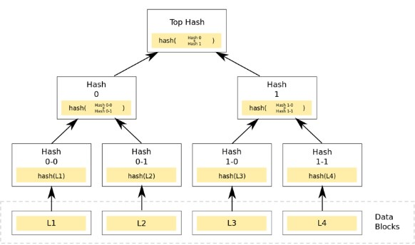
Asset store and the Patricia Merkle trie
Asset store attributes
Asset ID
Asset value
Asset balance
Currency symbol
Transaction type [debit, credit, debit block, etc]
Contract ID
Request hash
Response hash
Tx hash (status)
Asset and Transaction data on the Verified blockchain are stored in Patricia Merkle tries.

Slide 6
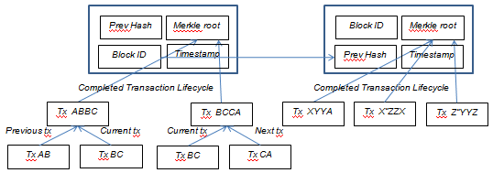
Transaction stores
All transactions are clubbed into blocks that are chained [hence, the term blockchain]
Verified transaction store [used by certifying peers]
Sender ID
Counter party (receiver) ID
Request hash
Response hash
Previous peer
Next peer
Status
Tx hash
Block ID
Timestamp
Transaction store [used by each peer to store its own transactions]
Transaction hash
Transaction type
Block identifier
Certifying peer ID
Counter party (receiver) ID
Sender ID
Timestamp

Slide 7
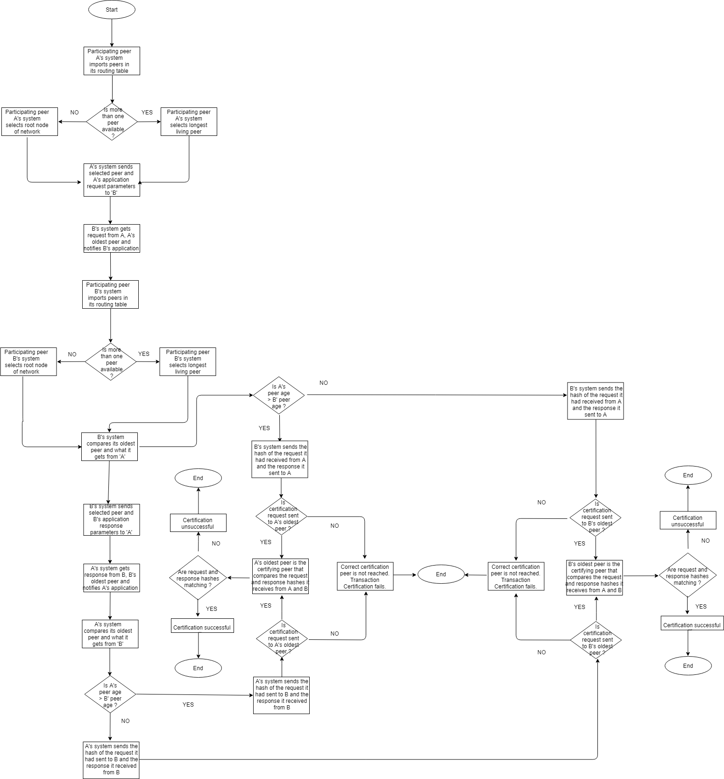
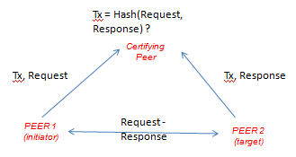
Certifying a transaction

Slide 8
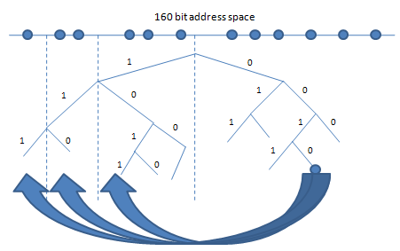

Peer discovery and Communications
DISCOVERY
2¹⁶⁰ network address space, O(log_{n}) hops. Iterative, asynchronous look up.
COMMUNICATIONS
Sender signs message with its private key, encrypts using public key of receiver. Receiver decrypts message using its private key, checks signature using sender’s public key.

Slide 9
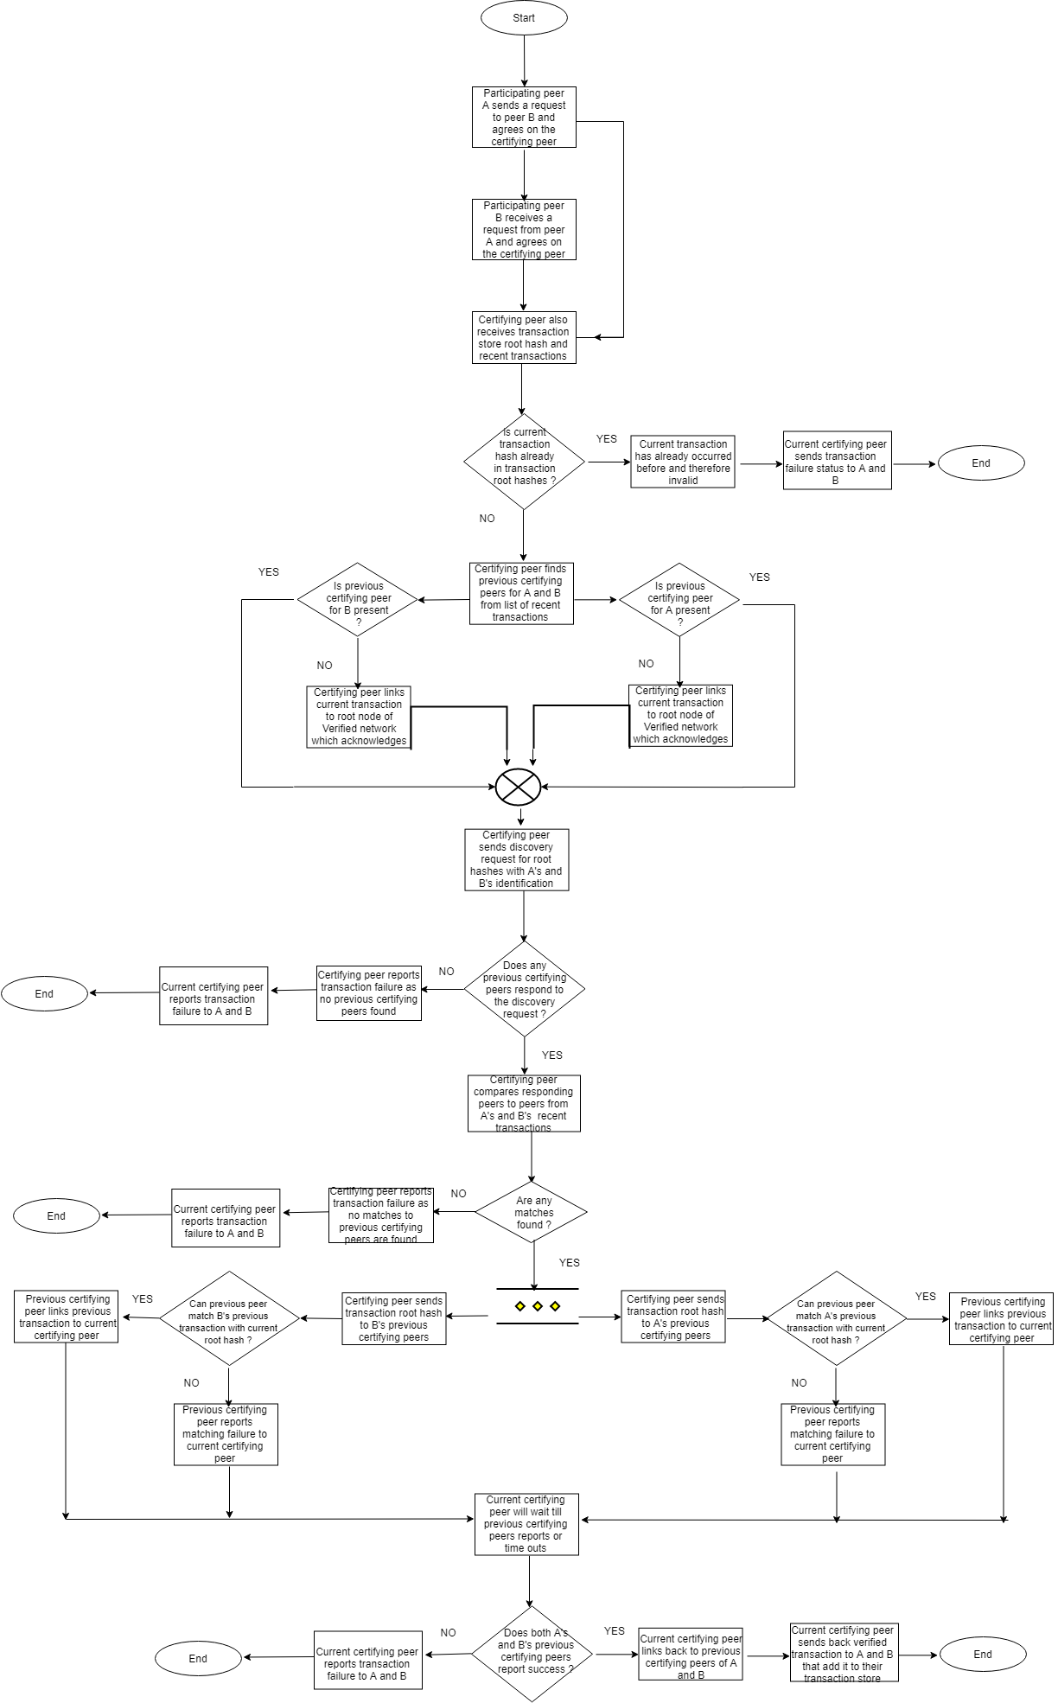
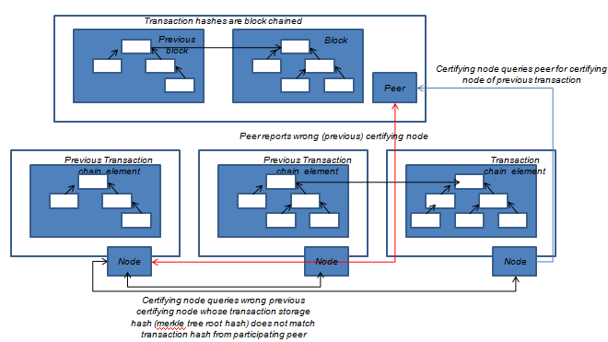
Verifying a transaction

Slide 10
Provided and Required APIs
Required APIs
Asset APIs
requestIssue()
requestRedemption()
requestExchangeRate()
Storage APIs
TBD
Provided APIs
Authentication APIs
signUp()
signIn()
signOut()
Asset store APIs
checkBalance()
canDebit()
Transaction APIs
send()
publish()
subscribe()
verify()
store()

Slide 11
Setting up the Verified blockchain
Decentralized
Verified peers run dhtRunners themselves
Distributed
Verified peers connect to dhtRunner nodes running remotely either using RPCs or REST APIs

